Slide 1
Eaton Corporation (ETN)
October 18th, 2021 – Buy/Sell Recommendation Patrick Mann, Nick Krause, Mason Collins

Slide 2
Table of Contents
Section I. Company Overview
Section II. Industry Overview
Section III. Risks & Catalysts
Section IV. Valuation
Section V. Investment Thesis / Recommendation

Slide 3
Section I. Company Overview
Analyst(s):

Slide 4
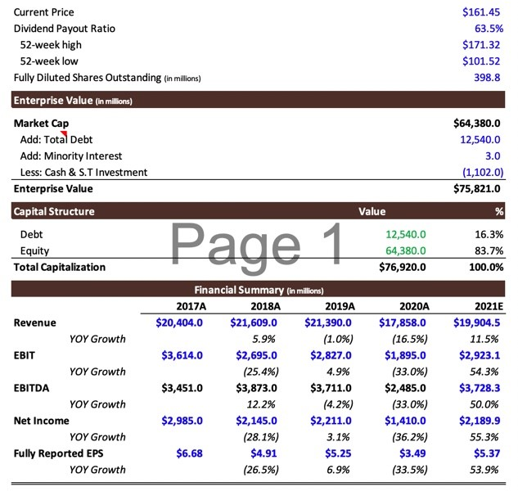
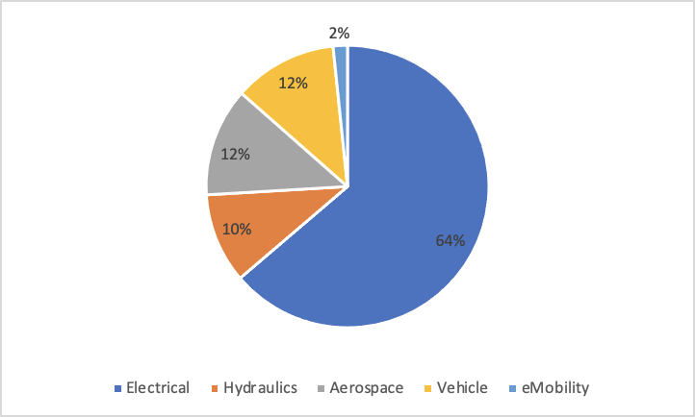
Company Summary
Eaton Corporation (ETN)
Financial Summary
Multinational power management company founded in 1911 now having grown to have operations in electrical, aerospace, vehicle, and eMobility sectors
Having business in more than 175 countries and 85k employees around the world
Wide range of products from power management tools, fuel efficient systems, to commercial and military aircrafts
Growth strategy focused on investment in technology, partnerships and value creation for customers to accelerate organic growth in high-growth and high-margin areas of their business
CEO & President: Craig Arnold, CFO: Thomas B. Okray
Revenue Breakdown
Sources: Company Website, SEC 10Ks 10Qs, Yahoo Finance

Slide 5
Business Model/Acquisitions
Eaton believes the quickest way to grow the business was through acquisitions and began buying companies in numerous industries. Since their IPO in 1923 they have acquired 46 businesses.
Sources: Company Website, SEC 10Ks 10Qs

Slide 6
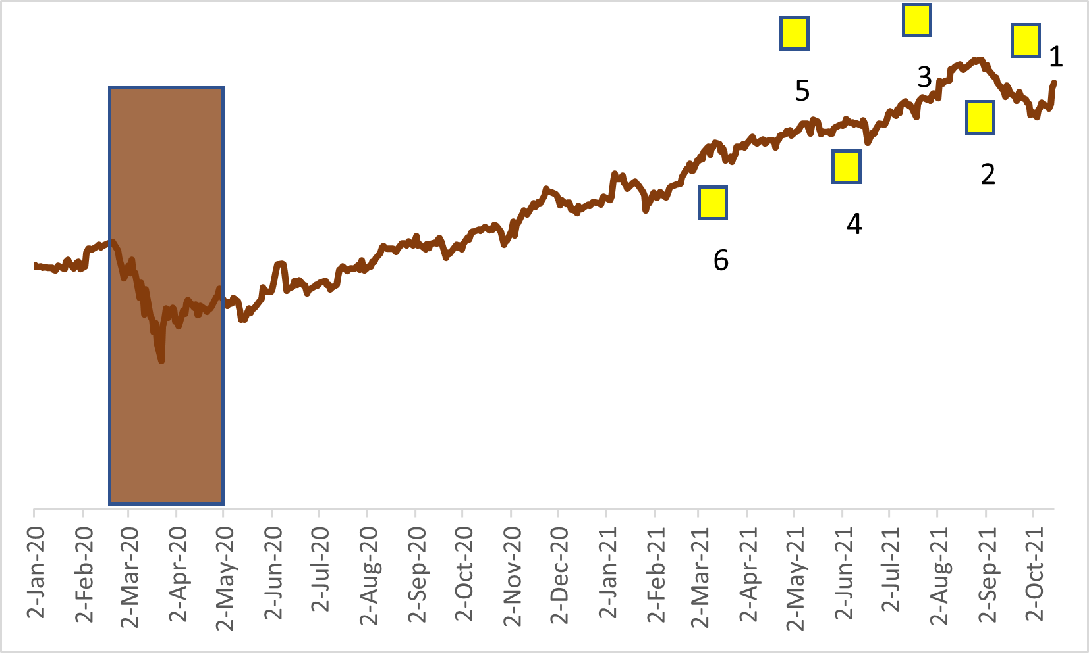
Annotated Price Chart
Stock Chart
Major Events
10/08/2021 - Eaton announces it has entered into a new 5-year credit agreement
08/27/2021 - Eaton paid out is quarterly dividend of $0.76 per share
08/03/2021 - Eaton announces record second quarter earnings report, boosting investor optimism
06/01/2021 - Eaton finishes the acquisition of Cobham Mission Systems, a defense contractor
04/26/2021 - Eaton announces plans to acquire a 50% stake in Jiangsu YiNeng Electric’s busway business
03/22/2021 - Eaton acquires Green Motion SA, an electric vehicle charging company
Sources: Company Website, Yahoo Finance

Slide 7
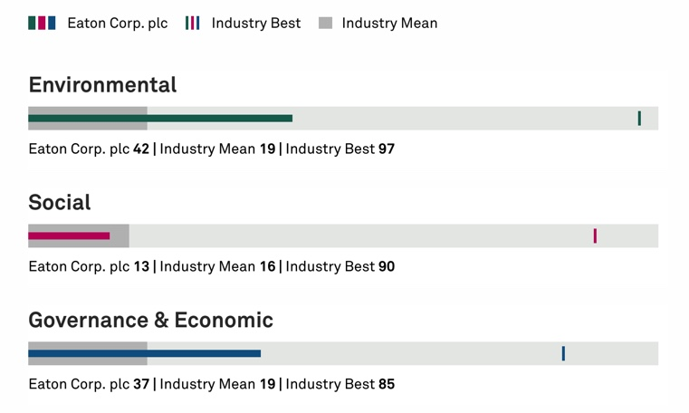
Eaton Corporation & ESG
Sustainability
Aligned with UN Sustainable Development Goals(SDGs) with benchmark goals for 2030
Reduce GHG emissions from operations by 50% of 2018 levels
Have 100% of manufacturing sites zero waste to landfill certified
Invest $3b in R&D targeted at creating sustainable solutions
Included in the Carbon Clean 200 list
ESG score: 32
Sources: Company Website

Slide 8
Section II. Industry Overview
Analyst(s):

Slide 9
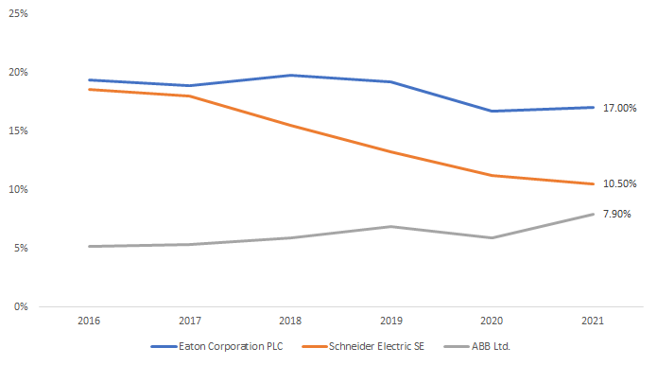
Industry Overview
Greater demand for energy-efficient electrical equipment and investment into the country’s aging infrastructure is expected to drive the Electrical Equipment Manufacturing industry forward.
Demand Determinants
Market Share by Revenue
Growth in demand for electricity
Rising cost of energy
Demand for construction
Investment in energy-efficient technologies
Industry Trends
Mature industry
Increased merger and acquisitions
Expected rebound in manufacturing and construction
Sources: Bloomberg CCB Function
Notes:
The major factors driving demand for electrical equipment include the following: growth in demand for electricity; the rising cost of energy and electricity; per capita disposable income; demand for construction, and the need for secure power.
In addition, government laws, regulations and policies affect demand for industry products. The importance of the drivers and demand determinants for electrical equipment can vary by electrical product. Every product in this industry is affected by per capita disposable income to a degree because downstream industries that purchase industry products only demand as much as can satisfy their consumer demand. Thus, the demand determinants which face this industry's downstream markets have significant effects on the industry as well. Since industry products are essential components in a wide variety of finished goods, demand within this industry is not significantly affected by seasonality and no close substitutes are easily available.
Demand for motor and generator products is fueled by general economic growth, consumer spending and industrial production. Demand for switchgear equipment is affected by spending on transmission network substations and by building construction and renovation activity. Similarly, demand for relay and industrial control products is largely driven by increases in industrial production and building construction. Thus, the industry is highly sensitive to the macroeconomic environment and capital expenditure levels.
Over the five years to 2021, revenue for the Electrical Equipment Manufacturing industry has grown despite difficult operating conditions bookending the current period. In 2016, the industry was still enduring the effects of China's sudden decline in GDP and its shock to commodities. However, following this, the industry experienced robust growth as global industrial activity rebounded and major companies undertook acquisitions. This growth offset the significant effect of the COVID-19 (coronavirus) pandemic on the industry as global economic activity slowed. widespread vaccine distribution in 2021 has spurred an economic recovery, industry operators struggle to keep up with pent-up demand, reporting long lead times and idle capacities, amid supply chain disruptions and labor shortages. However, supply shortages have shifted pricing power to manufacturers, encouraging profit growth. Overall, a rebound in the industrial production index has enabled industry manufacturers to recover from pandemic-induced lows. Resultingly, industry revenue is estimated to increase an annualized 0.6% to $41.1 billion over the five years to 2021, including a 5.0% recovery in 2021.

Slide 10
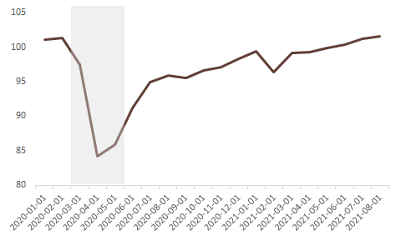
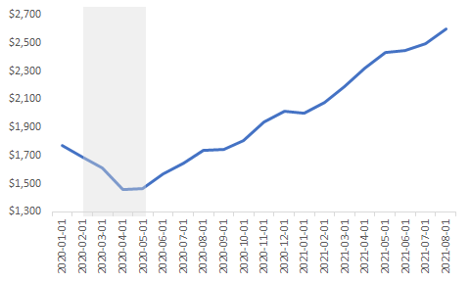
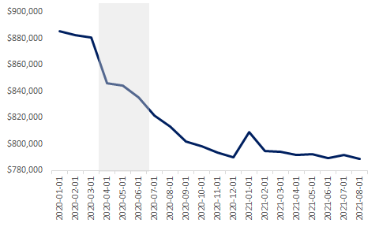
Macro Overview
Industrial Production: Total Index
Global Price of Aluminum ($ per metric ton)
Total Construction Spending: nonresidential
Sources: FRED
Notes:
Industrial production index
The industrial production index measures the output of the manufacturing, mining and utility sectors. The industrial sector has the highest energy consumption rate, and, thus, as industrial production grows, the sector's demand for electricity grows, which supports spending on electrical infrastructure and industry products. Similarly, many industrial production processes require electrical equipment as component parts for end products. In 2021, the industrial production index is expected to increase 4.9%.
World price of aluminum
Aluminum is an essential raw material for electrical equipment manufacturing. Thus, as a significant input cost to industry manufacturers, the world price of aluminum influences industry revenue. As the world price of aluminum increases, manufacturers' production costs increase and are absorbed by the consumer in the form of higher prices. In 2021, the world price of aluminum is expected to increase.
Value of private nonresidential construction
Construction markets rely on electrical equipment manufacturers to produce products to use as inputs in construction projects, primarily nonresidential construction. Thus, as nonresidential construction increases, demand for electrical equipment increases as well. The value of private nonresidential construction declined in 2020 as companies reduced investment or deterred projects in wake of the COVID-19 (coronavirus) pandemic. In 2021, the value of nonresidential construction is expected to calcine, posing a threat to industry operators.

Slide 11
Section IV. Risks & Catalysts
Analyst(s):

Slide 12
Risks and Catalysts
Risks
Catalysts
Supply chain fluctuations from COVID crisis including iron, steel, and oil could affect profitability
Tapering quantitative easing
Tightening regulations, increased competition in energy industry
Rising interest rates
Growth in demand for aerospace industry products spurred by growth in air traffic
Fuel efficiency, lower emissions, electric vehicles grow demand for e-vehicle products
World transitioning towards Internet of things, demand rises for IT products
Infrastructure bill
Positive earnings expectations
Consistent dividend growth
Despite recent supply chain fluctuations within basic materials such as metal and oil, this volatility should be subsiding the further we get from the COVID-19 crisis.
Eaton will benefit from growth in the aerospace, electric vehicle and data industries following the COVID-19 crisis.
Sources: Company Website, SEC 10Ks 10Qs, Yahoo Finance

Slide 13
Section V. Valuation
Analyst(s):

Slide 14
Comparable Company Analysis – Base Case
Sources: WSJ, Yahoo Finance, 10k

Slide 15
Multiples Analysis

Slide 16
NASDAQ 12-Month estimates
Sources: Nasdaq

Slide 17
Section VI. Investment Thesis
Analyst(s):

Slide 18
ETN Investment Thesis
Company Overview / Story - Mature
Business Model / Growth Strategy
Multinational power management company founded in 1911 now having grown to have operations in electrical, aerospace, vehicle, and e-Mobility sectors
Business in more than 175 countries and 85k employees around the world
Growth strategy focused on investment in technology, partnerships and value creation for customers to accelerate organic growth in high-growth and high-margin areas of their business
Commitments towards R&D regarding power management.
Risks & Catalysts
Valuation
Supply chain fluctuations from COVID crisis including iron, steel, and oil could affect profitability
Rising interest rates
Fuel efficiency, lower emissions, electric vehicles grow demand for e-vehicle products
World transitioning towards Internet of things, demand rises for IT products
We performed comparative analysis by reviewing similar companies and analyzing similarities and differences
Nasdaq estimates from 9 different analysts suggest an avg price target of $173.29, with a high of $195, suggesting plenty of upside to this stock
Investment Thesis - Buy
With growing energy demands or opportunities for more sustainable manufacturing, ETN bridges that barrier to more efficient and sustainable power management systems
Given the ongoing demand for EV vehicles, ETN’s background of extensive knowledge dealing with power management lead us to believe they will be a great company in the automotive industry

Slide 19
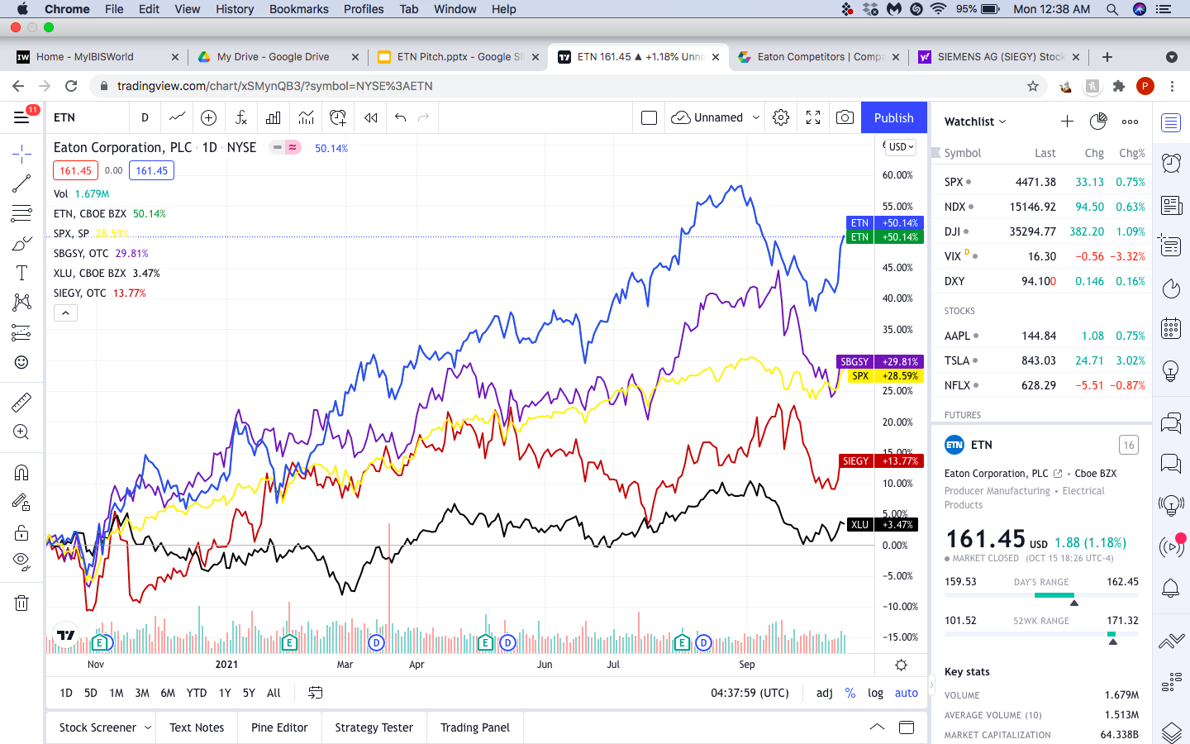
Investment Thesis
ETN vs S&P 500 and competitors

Slide 20
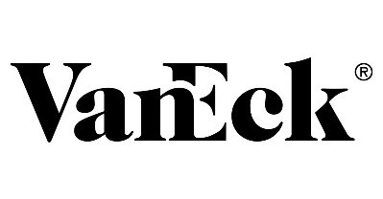
Security Summary
Utilities Select Sector SPDR Fund (XLU)
Financial Summary
The Utilities Select Sector SPDR® Fund seeks to provide investment results that, before expenses, correspond generally to the price and yield performance of the Utilities Select Sector Index (the “Index”)
Primarily provides companies that produce, generate, transmit or distribute electricity or natural gas
The Index seeks to provide an effective representation of the utilities sector of the S&P 500 Index
 | Current Price |  |  |  |  | $65.68
 | Net Asset Value (NAV) |  |  |  |  | $65.84
 | Total Net Assets ($M) |  |  |  |  | $41,339.2
 | 52-week high |  |  |  |  | $70.07
 | 52-week low |  |  |  |  | $58.27
 | Shares Outstanding (M) |  |  |  |  | 188.3
 | Gross Expense Ratio |  |  |  |  | 0.12%
 | Inception Date |  |  |  |  | 12/16/98
 | Number of Holdings |  |  |  |  | 29
 | Price/Earnings Ratio |  |  |  |  | 23.2x
 | Price/Book Ratio |  |  |  |  | 2.2x
 | Top 10 Holdings
 | Number | Ticker | Holding Name | Shares | Market Value ($M) | % of Net Assets
 | 1 | NEE | NextEra Energy Inc | 26,288,218 | $160,210.0 | 17.36%
 | 2 | DUK | Duke Energy Corp | 10,309,418 | $77,203.0 | 8.36%
 | 3 | SO | Southern CO | 14,188,628 | $66,844.0 | 7.24%
 | 4 | D | Dominion Energy Inc | 10,834,041 | $59,100.0 | 6.40%
 | 5 | EXC | Exelon Corp | 13,103,238 | $48,706.0 | 5.28%
 | 6 | AEP | American Electric Power Co Inc | 6,703,528 | $41,766.0 | 4.52%
 | 7 | SRE | Sempra Energy | 4,279,052 | $41,005.0 | 4.44%
 | 8 | XEL | Xcel Energy Inc | 7,215,264 | $35,499.0 | 3.85%
 | 9 | PEG | Public Service Enterprise Group Inc | 6,774,878 | $31,401.0 | 3.40%
 | 10 | AWK | American Water Works Co Inc | 2,432,155 | $31,112.00 | 3.37%
 |  |  |  | Total: | $592,846.00 | 64.22%
Sources: VanEck, Yahoo Finance

Slide 21
Recommendation
Recommendation
Change in Utilities
“We want to initiate a 2.0% position in Eaton Corporation at a price target of $195, representing a 20.8% potential upside from the current market price.”
“We want to fully reduce our 1.91% stake in XLU at a price of $65.68 representing a 4.49% share price increase from our purchase price of 62.86$”
1.89%
XLU
Sources: Yahoo finance, SIMM Google Sheet

Slide 22
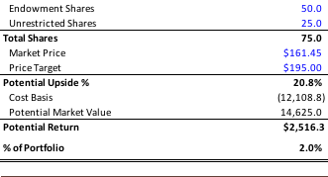
Recommendation
Sell Recommendation
Buy Recommendation
Current shares |  |  |  |  | 170.0
Endowment Shares |  |  |  |  | 113.0
Unrestricted Shares |  |  |  |  | 57.0
Total Shares Sold |  |  |  |  | 170.0
Total Shares Remaining |  |  |  |  | 0.0
Market Price |  |  |  |  | $65.68
Purchase Price |  |  |  |  | $62.86
Upside % |  |  |  |  | 4.5%
Cost Basis |  |  |  |  | (10,686.2)
Market Value |  |  |  |  | 11,165.6
Total Realized Gains |  |  |  |  | $479.4
Unrestricted Gains |  |  |  |  | 241.8
Endowment (2/3) |  |  |  |  | 158.4
Endowment (1/3) |  |  |  |  | 79.2
SIMM Realized Gains |  |  |  |  | $321.0
Years held |  |  |  |  | 1.6 Years
Annualized Return |  |  |  |  | 2.7%
% change in Portfolio |  |  |  |  | (1.9%)
% remainder of Portfolio |  |  |  |  | 0.0%
Sources: Yahoo finance, SIMM Google Sheet

