Slide 1

Reliance Steel (RS)
Basic Materials Sector
September 8th, 2021 – Buy/Sell Recommendation Drake Dettore & Matt Leamon

Slide 2
Table of Contents
Section I. Company Overview
Section II. Industry Overview
Section III. Risks & Catalysts
Section IV. Valuation
Section V. Investment Thesis / Recommendation

Slide 3
Section I. Company Overview
Analyst(s): Drake Dettore

Slide 4
Company Summary
Reliance Steel & Aluminum Co.
Financial Summary
Leading diversified metal solutions provider founded in 1939 headquartered in Los Angeles, CA with over 13,000 employees
Around 300 locations in 40 U.S. States and 13 international countries, providing a full line of over 100,000 metal products
Metal products include alloy, aluminum, brass, copper, carbon steel, stainless steel, titanium, etc.
Growth strategy focused on increasing operating growth through organic growth and strategic acquisitions within the industry
The Reliance steel family of companies is made up of more than 75 brands
CEO: James Hoffman, CFO: Arthur Ajemyan, President: Karla Lewis
Revenue Breakdown
Sources: Company Website, SEC 10Ks 10Qs, Yahoo Finance

Slide 5
Business Model
Reliance has a very simply business model. Their growth strategy is based on strategic acquisitions. Since their IPO in 1994 they have acquired 67 businesses and with the recent Merfish announcement that number will soon be 68.
Reliance Steel:
>100,000 Metal Products
Pre-made finished goods
Customers
Raw Materials
Raw Materials
Subsidiaries'
Finished goods
Sources: Company Website, SEC 10Ks 10Qs

Slide 6

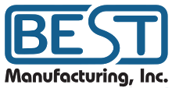




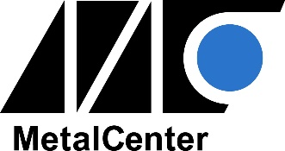

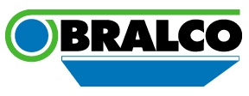


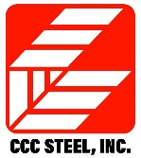

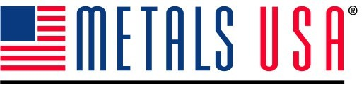

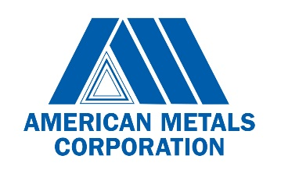
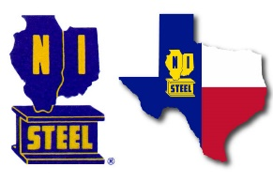






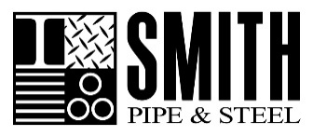
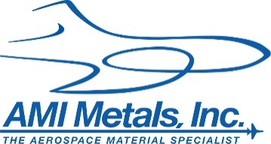

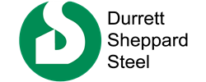
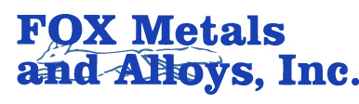

Business Model – Acquisitions
Sources: Company Website, SEC 10Ks 10Qs

Slide 7
Annotated Price Chart
Stock Chart
Major Events
Reliance Steel announces pricing of $900 M senior notes offering. Net proceeds used to repay outstanding indebtedness, loans, and general corporate purposes
Q3 2020 report shows record gross margin of 32.4% and non-GAAP EPS growth of 37.5% from the prior quarter
Q4 & Full Year 2020 report shows record gross margin of 31.5%, $337.3 M annual share repurchases, 10% increased quarterly dividends, and decrease in bottom line of (29.3)% (due to effects of Covid-19 on steel industry
Q1 2021 report shows record quarterly gross profit of $953.7 M and record gross profit margin of 33.6%. Record quarterly diluted EPS of $4.12, an 105% increase from Q4 2020
Q2 2021 report shows record quarterly net sales of $3.42 B and record quarterly diluted EPS of $5.08, an increase of 23.3% from Q1 2021
Reliance agrees to acquire Merfish United, a leading distributor of tubular building products which serves 47 states in the US and had approximately $500 M in sales over LTM
Sources: Company Website, Yahoo Finance

Slide 8


Reliance & ESG
Sustainability
  Significant raw materials purchased from electric arc furnaces
  Sell all scrap materials (mostly steel) from operations to recyclers
  Use propane fuel to operate forklifts / installing solar panels on warehouses
  Proprietor trucking fleet uses diesel tractors which consumer less fuel and reduce emissions
Community
  Work with veteran non-profits to provide education & careers in welding / machining / fabrication
  Subsidiaries who promote or organize community fundraising events will have raised funds matched by Reliance to incentivize civic contributions
  Reliance Cares
    Launched in 2017, supports any members of their workforce who are affected by natural disasters
    Hurricanes Harvey & Irma: provided financial assistance to 135 employees and funded 27 grants to help in rebuilding efforts

Slide 9
Section II. Industry Overview
Analyst(s): Matt Leamon

Slide 10
Steel Processing Industry Overview
The Global Steel Processing industry generated roughly $83.4B in 2020, with $13.6B generated in North America. Reliance Steel is controlling most of the North American market share. With only 7% of their revenue coming internationally, there is room to grow.
North American Market Share - % of Rev.
Global Market Share - % of Rev.
North American Market Share - % Mkt. cap
Global Market Share - % Mkt. cap
Sources: Bloomberg CCB Function

Slide 11
Macro Overview
The areas shaded in grey show the recent recession caused by the Covid-19 pandemic. As shown, commodity prices have risen significantly due to aggressive monetary policy. If the Fed begins tapering, Reliance & the steel industry could suffer due to its cyclical nature.
Major Indices YTD Price Change
PPI: Cold Rolled Steel Sheet and Strip
PPI: Iron and Steel: Pipe, Tube, and Carbon
Global Price of Aluminum ($ per Metric Ton)
Sources: Yahoo finance, FRED

Slide 12
Section IV. Risks & Catalysts
Analyst(s): Matt Leamon

Slide 13
Risks and Catalysts
Risks
Catalysts
COVID-19 supply chain disruptions
Fluctuating metal prices and customer demand
Removal of Section 232 tariffs
Microchip shortage and automotive production
Quantitative Tightening
Cyclical Industry
Growth through consolidation and strategic acquisitions
Significant investment in state-of-the-art equipment and advanced technology
Infrastructure bill
Positive Earnings expectations
Exposure to aerospace and defense sector, specialized products
Ex. Dividend Date is 9/12/21
Although Reliance faces metal supply constraints, long-standing relationships with suppliers and the ability to cross-sell inventory among the family of companies allow RS to meet demand.
Reliance will continue to consolidate through strategic acquisitions and is poised to benefit from the continuation of steel price increases.
Sources: Company Website, SEC 10Ks 10Qs, Yahoo Finance

Slide 14
Section V. Valuation
Analyst(s): Drake Dettore

Slide 15
Dividend Discount Model – Base Case

Slide 16
Comparable Company Analysis – Base Case

Slide 17
Multiples Analysis – Base Case

Slide 18
Discounted Cash Flow Statement – Base Case
Discount Rate
Discount Rate

Slide 19
Football Field – Base Case
We weight our Perpetuity DCF higher than our Terminal EBITDA DCF due to the cyclical nature of the steel industry and the likelihood the industry will continue to grow in-line with population & inflation
We believe Price to Book is the most important multiple to consider when valuating RS as it is a large manufacturer with a great deal of tangible assets
Our “Base Case” is mostly in line with wall streets consensus assumptions. However, we are more bullish on reliance than wall street, and therefore allocate more weight to our “Bull Case”

Slide 20
Section VI. Investment Thesis
Analyst(s): Drake Dettore & Matt Leamon

Slide 21
RS Investment Thesis
Company Overview / Story - Mature
Business Model / Growth Strategy
Leading diversified metal solutions provider founded in 1939 headquartered in Los Angeles, CA with over 12,800 employees
Around 300 locations in 40 U.S. States and 13 international countries, providing a full line of over 100,000 metal products
Metal products include alloy, aluminum, brass, copper, carbon steel, stainless steel, titanium, etc.
Founded in 1939 / Public on NYSE in 1994
Reliance provides metal products to customers, either through finished goods completely owned by Reliance, or by processing raw materials sent to Reliance by customers
Reliance Family consists of 75 brands and subsidiaries work in their specialized fields ( I.E. Diamond Co. perforates sheets)
Growth strategy focused on strategic acquisitions; 67 since IPO
Risks & Catalysts
Valuation
Reliance is a cyclical industry highly dependent on the current economic conditions of the U.S.
The current administration can have a large impact on reliance regarding the Section 232 tariffs and the infrastructure plan
The enormous increase in steel prices as well as Reliance’s increase in gross margins has led to extremely positive earnings expectations for Q4 and full year 2021
This along with the coming ex-dividend date is an attractive investment
We preformed Dividend discount analysis, discounted cash flow analysis (two methods) and comparable company analysis with an emphasis on four multiples
Of these only two suggested Reliance may be overvalued, with the remaining five supporting further expansion in share price
We weighted our DCF to Perpetuity and our Price to Book valuations the highest as they seemed most applicable to Reliance and their industry
Investment Thesis - Buy
Although the steel industry has been seeing unexpectedly high prices, we believe Reliance is currently undervalued and has room to grow in their industry, specifically internationally
We are suggesting a limit order price of $155 for a price target of $190. We expect a investment horizon of 3 – 5 months, but will remain reevaluating the situation consistently

Slide 22
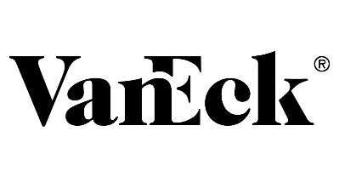
Security Summary
VanEck Vectors Steel ETF (SLX)
Financial Summary
Vectors Steel ETF (SLX ) seeks to replicate as closely as possible, before fees and expenses, the price and yield performance of the NYSE Arca Steel Index (STEEL), which is intended to track the overall performance of companies involved in the steel sector.
Sources: VanEck, Yahoo Finance

Slide 23
Recommendation
Recommendation
Change in Basic Materials
“We want to initiate a 3.1% position in Reliance Steel at a price target of $190.00, representing a 22.6% potential upside from the current market price.”
“We want to reduce our 6.0% stake in SLX by (4.0%) at a price of $61.22 representing a 175% share price increase from our purchase price of $23.30.”
Sources: Yahoo finance, SIMM Google Sheet

Slide 24
Recommendation
Sell Recommendation
Buy Recommendation
Sources: Yahoo finance, SIMM Google Sheet

