Slide 1
NXP Semiconductors N.V. (NXPI)
Technology Sector
September 22nd, 2021 – Buy/Sell Recommendation Colin Fragale, Patrick Seeley, & Justin Schultz

Slide 2
Table of Contents
Section I. Company Overview
Section II. Industry Overview
Section III. Risks & Catalysts
Section IV. Valuation
Section V. Investment Thesis / Recommendation

Slide 3
Section I. Company Overview
Analyst(s): Colin Fragale and Justin Schultz

Slide 4
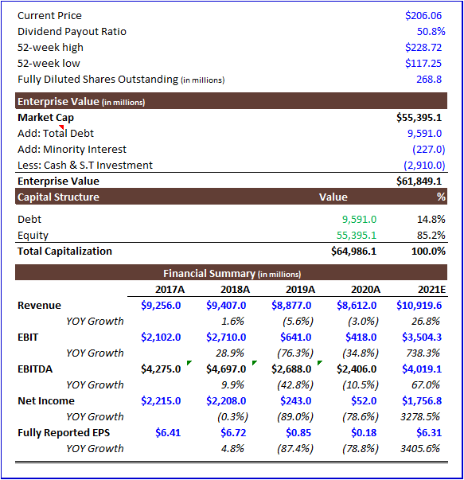
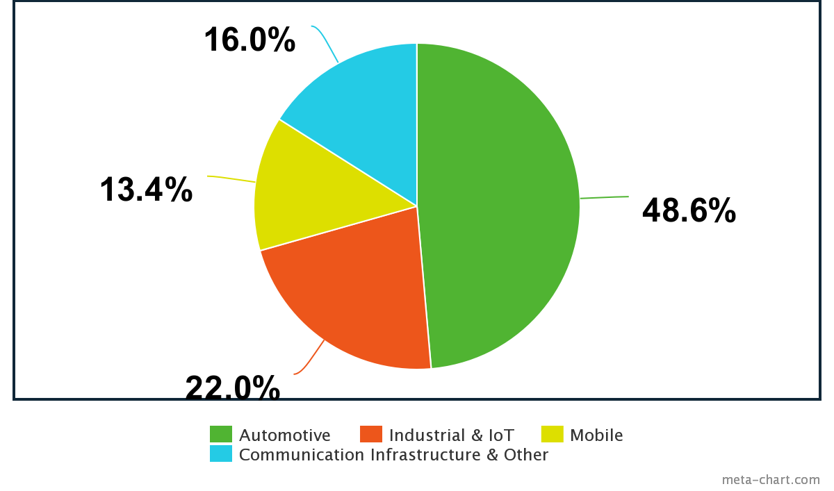
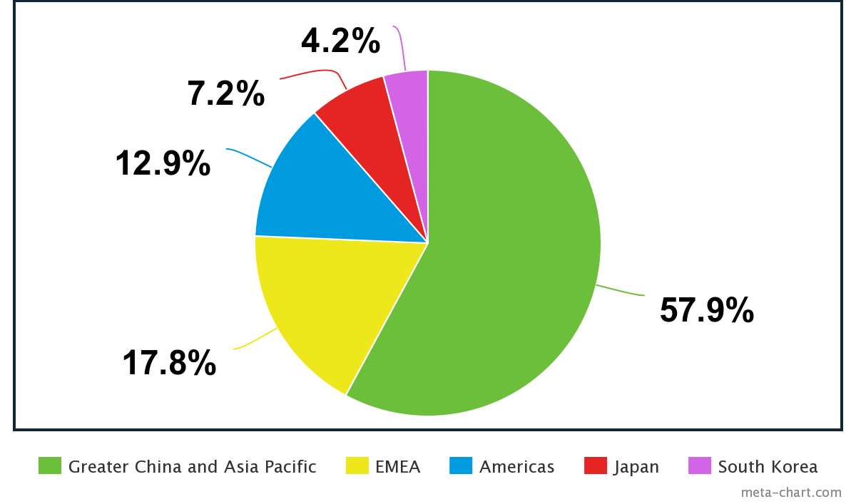
Company Summary
NXP Semiconductors N.V.
Financial Summary (in millions)
Semiconductor company focused on the automotive industry that is headquartered in Eindhoven, Netherlands.
The company employs approximately 31,000 people in more than 35 countries.
As of 2016 is fifth largest non-memory semiconductor company.
Provides products for Autoliv, Bosch, and Delphi Technologies.
NXP Semiconductors used to be part of Philips until it spun off into its own company.
President and CEO: Kurt Sievers, CFO: Peter Kelly
Revenue Breakdown
Sources: Company Website, SEC 10Ks 10Qs, Yahoo Finance, meta-chart.com

Slide 5
Acquisition History
Freescale Semiconductor
NXP merged with Freescale Semiconductor in 2015.
Semiconductor company formed by Motorola in 2004.
Freescale focused mainly on automotive, embedded, and communication markets.
Acquired by Blackstone Group in 2006 and was merged with NXP Semiconductors nine years later.
Focus remains on embedded, communication, and primarily automotive markets.
Qualcomm’s Attempt to Acquire NXP Semiconductors
Qualcomm is an American multinational technology that creates semiconductors, software, and services related to wireless technology.
Attempted to acquire NXP Semiconductors from 2016 to 2018 for the semiconductor technology.
Bid up to $44 billion for NXP but the deal fell through as China would not approve the acquisition.
Samsung’s Contemplation of Acquiring NXP Semiconductors
Samsung, the giant South Korean multinational technologies company, was in search of a semiconductor company to acquire, and had its eyes set on NXP.
Samsung wanted NXP’s automotive semiconductor technology.
However, NXP was valued up to $69 billion by August 2021, so Samsung has reconsidered the acquisition because antitrust problems would likely arise.
Sources: Wikipedia, SEC 10Ks 10Qs

Slide 6
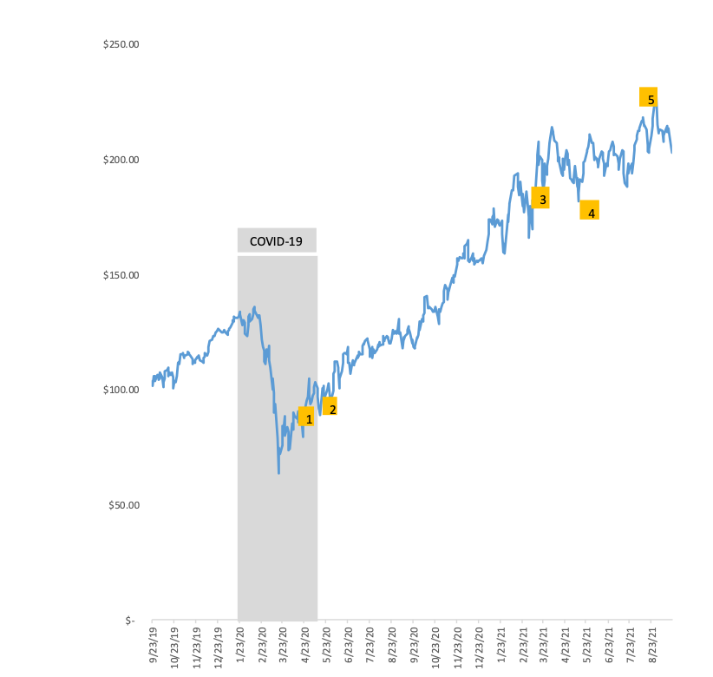
Annotated Price Chart
Stock Chart
Major Events
61% Earnings Beat April 27, 2020
Kurt Sievers elected as an executive director and the company’s Chief Executive Officer
NXPI Added to S&P 500
NXP Semiconductors Names Andy Micallef as Executive Vice President, Global Operations
Samsung No Longer Interested in Acquiring NXPI
Sources: Company Website, Yahoo Finance

Slide 7
NXP & ESG
Sustainability
To drive positive change and sustainable growth
Three values: Engage, Protect, and Respect
30% reduction in carbon footprint
47% of water recycled
Community
Committed to supporting the UN’s Sustainable Development Goals (SDGs)
Global community outreach that aligns with these goals
NXP’s Extensive Outreach
NXP USA works with Code2College to provide opportunities in STEM to underrepresented backgrounds in technology.
NXP France helped provide victims of flooding in Saint Martin de Vesubie after 2020 storm by cleaning beaches and streets.
Sources: Company Website

Slide 8
Section II. Industry Overview
Analyst(s): Patrick Seeley

Slide 9
Sources: Hedgeye

Slide 10
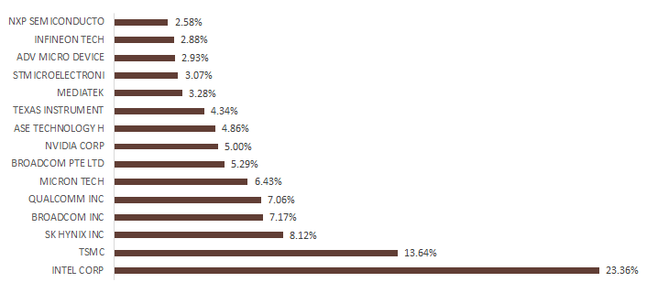
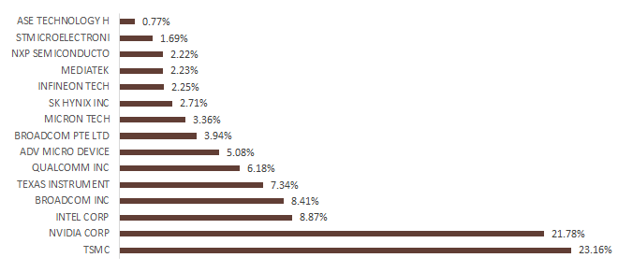
Semiconductor Industry Overview
The Global Semiconductor industry generated roughly $110.61B in 2020. NXP Semiconductor is a Dutch company with locations across the globe. A 2.58% global market share leaves them with plenty of room to grow during this time of high demand.
This industry manufactures electronic components, which are typically packaged in a discrete form with two or more connecting leads or metallic pads. Connecting these parts by soldering them to a printed circuit board creates an electronic circuit. A semiconductor device is an electronic component made with semiconductor material, such as silicon.
External Drivers of the Industry
GDP of the BRIC(Brazil, Russia, India, China) nations
Global internet usage
Global per capita income
Global number of mobile phone subscriptions
World price of copper
Fueled mainly by semiconductors and their related devices, industry trade is projected to increase at an annualized rate of 3.8% to $226.8 billion over the five years to 2026.
Tariffs do affect the first and second tier suppliers of these companies.
Global Market Share - % of Rev.
Global Market Share - % Mkt. cap
Sources: Bloomberg CCB Function, IBISWorld

Slide 11
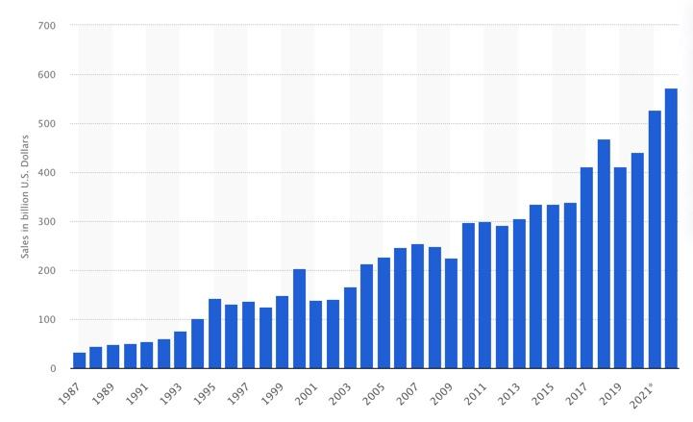
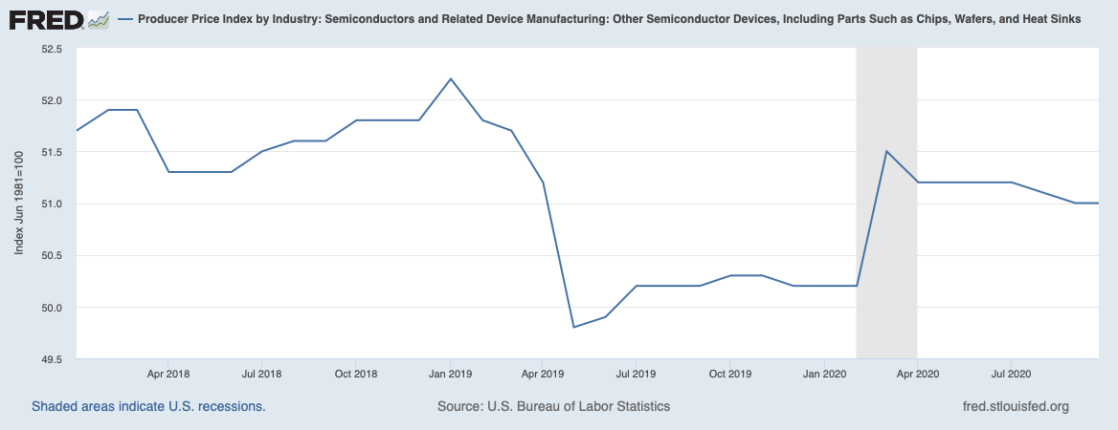
Macro Overview
Semiconductors continue to be in high demand as the global shortages continue. There are semiconductors in most circuit boards which are used in anything electronic. This being said, as new technology comes out and the world continues to use electronics, the demand will continue to rise.
Semiconductor market size worldwide from 1987 to 2022
(in billions of USD)
PPI: Semiconductor and Related Device Manufacturing
Sources: FRED, Statista.com

Slide 12
Section III. Risks & Catalysts
Analyst(s): Patrick Seeley and Colin Fragale

Slide 13
Risks and Catalysts
Risks
Catalysts
COVID-19 supply chain disruptions
Instability of the economy and markets
Price Erosion
Potential decreases in demand for products semiconductors are components of
The semiconductor industry is highly competitive
Highly Cyclical Industry
Selection by more companies as semiconductor provider
Increase in automotive demand would strongly impact revenue
Expected increase in earnings from 2021-2022
Advantage over US competitors given the US/China Trade War since the company is based in Europe
Development of EV related autonomous driving
Although NXPI faces market instability in a cyclical industry, long-standing relationships with established companies and their position as an established semiconductor provider in the automotive industry will ensure continued growth.
NXPI will continue to grow as semiconductor demand keeps increasing and EV’s become developed further.
Sources: Company Website, SEC 10Ks 10Qs, Yahoo Finance

Slide 14
Section IV. Valuation
Analyst(s): Colin Fragale

Slide 15
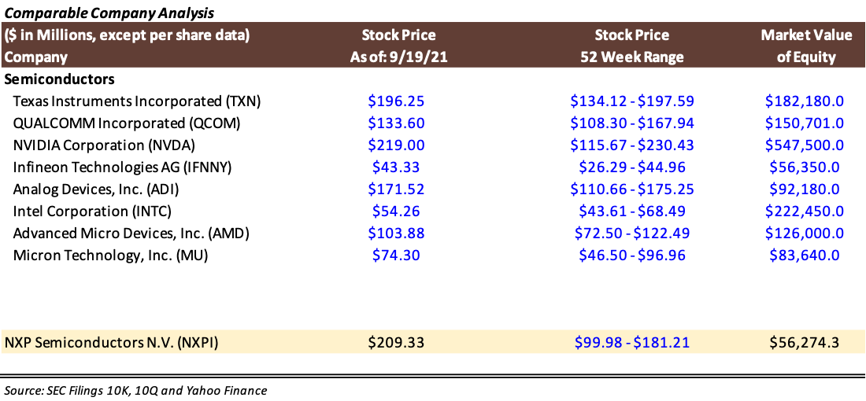
Comparable Company Analysis – Base Case

Slide 16
Multiples Analysis – Base Case
Sources: SEC 10Ks 10Qs, Yahoo Finance

Slide 17
Section V. Investment Thesis
Analyst(s): Colin Fragale and Patrick Seeley

Slide 18
NXPI Investment Thesis
Company Overview / Story - Mature
Business Model / Growth Strategy
Semiconductor company based in the Netherlands that focuses primarily on automotive semiconductors but also has exposure in the security and identification industry.
Located in 35 countries with over 31,000 employees.
Semiconductors focused on such things as NFC, RFID tags, and passive keyless entry.
Founded in 1953 under Philips / Public on NYSE in 2010
NXPI provides semiconductors to the automotive industry as well as the security and identification industry
Companies serviced include Bosch, Autoliv, and Delphi Technologies.
Growth strategy focused on further strengthening hold on automotive industry
Risks & Catalysts
Valuation
NXPI is in the cyclical industry of semiconductors, highly dependent on the current economic conditions of the world.
COVID-19 supply disruptions of inputs such as metals
Potential decrease in products NXPI’s semiconductors are used in
Potential to lose deals to other companies
We performed comparative analysis by looking at comparable companies and analyzing similarities and differences in multiples.
NXPI had one of the lowest EV/Sales multiples, indicating they have superior revenues compared to company size.
We made an estimation of the value of the company by weighting the low estimates of value with more consideration towards EPS and BVPS.
Investment Thesis - Buy
Given the dire need for semiconductors in a time when they are scarce, we believe NXPI Semiconductors is a great company that will gain more exposure as the automotive industry looks toward reliable providers
We are suggesting a market order of 66 total shares with a price target of $240. We expect an investment horizon of 8 – 12 months, but will monitor the company weekly

Slide 19
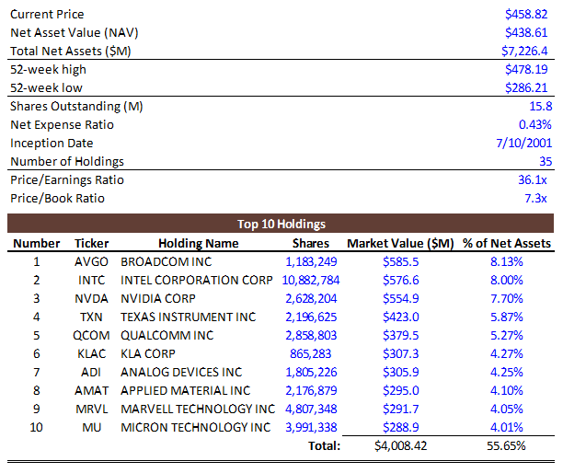
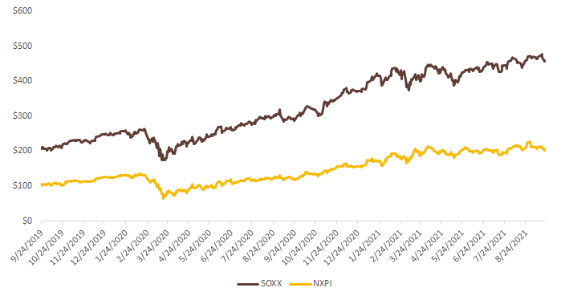
Security Summary
iShares Semiconductor ETF (SOXX)
Financial Summary
The iShares Semiconductor ETF seeks to track the investment results of an index composed of U.S.-listed equities in the semiconductor sector
Sources: VanEck, Yahoo Finance

Slide 20
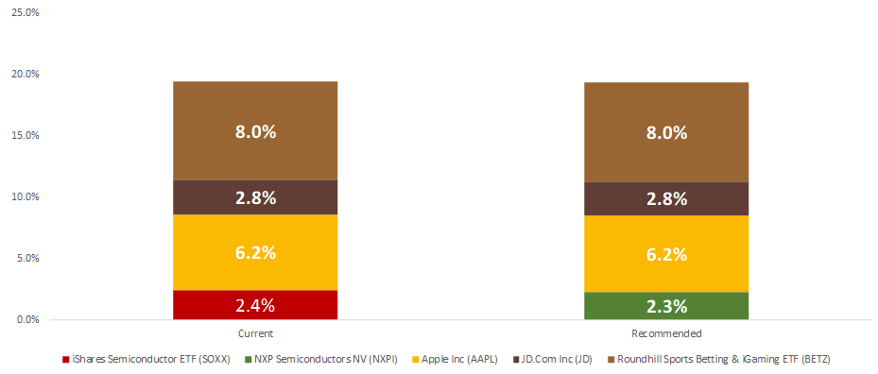
Recommendation
Recommendation
“We want to initiate a 2.3% position in NXPI at a price target of $240.00, representing a 15.8% potential upside from the current market price.”
“We want to sell all 30 shares of our 2.38% stake in SOXX at market price, representing a 97.1% share price increase from our purchase price of $233.98.”
Change in Technology
Sources: Yahoo finance, SIMM Google Sheet

Slide 21
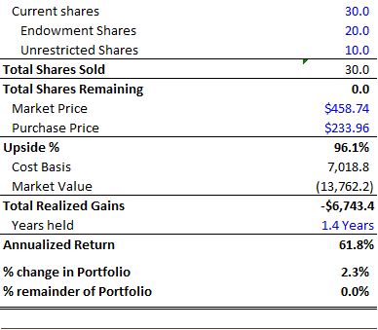
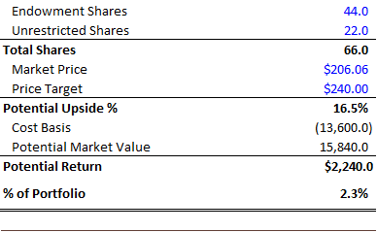
Recommendation
Sell Recommendation
Buy Recommendation
Sources: Yahoo finance, SIMM Google Sheet

