Slide 1
Alibaba (BABA)
Consumer Discretionary Sector
February 2nd, 2022 – Buy Recommendation

Slide 2
Table of Contents
Section I. Company Overview
Section II. Industry Overview
Section III. Risks & Catalysts
Section IV. Valuation
Section V. Investment Thesis / Recommendation

Slide 3
Section I. Company Overview
Analyst(s): Pat Mann and Ultan Horrigan

Slide 4
Company Summary
Alibaba
Financial Summary
The worlds biggest online commerce company founded in 1999 lead by Jack Ma
Three main sites; Taobao, Tmall, and Alibaba.com with transactions totaling $248 Billion last year – More than Ebay and Amazon combined
There are nearly a billion users and hosts millions of merchants and business
Moving into the Financial Services sector with Alibaba Alipay payments app
CEO: Daniel Zhang, CFO: Maggie Wei WU, President: Michael Evans
 | Current Price |  |  |  |  |  | $125.79
 | Dividend Payout Ratio |  |  |  |  |  | 0.0%
 | 52-week high |  |  |  |  |  | $274.29
 | 52-week low |  |  |  |  |  | $108.70
 | Fully Diluted Shares Outstanding (in millions) |  |  |  |  |  | 2710.0
 | Enterprise Value (in millions)
 | Market Cap |  |  |  |  |  | $340,890.9
 | Add: Total Debt |  |  |  |  |  | 183,160.0
 | Add: Minority Interest |  |  |  |  |  | (8,032.0)
 | Less: Cash & S.T Investment |  |  |  |  |  | 42,246.0
 | Enterprise Value |  |  |  |  |  | $558,264.9
 | Capital Structure |  |  |  |  | Value | %
 | Debt |  |  |  |  | 183,160.0 | 35.0%
 | Equity |  |  |  |  | 340,890.9 | 65.0%
 | Total Capitalization |  |  |  |  | $524,050.9 | 100.0%
 | Financial Summary (in millions)
 |  |  | 2018A | 2019A | 2020A | 2021A | 2022A
 | Revenue |  | $250,266.0 | $376,844.0 | $509,711.0 | $717,289.0 | $859,507.0
 |  | YOY Growth |  | 50.6% | 35.3% | 40.7% | 19.8%
 | EBIT |  | $103,969.0 | $101,411.0 | $171,825.0 | $170,054.0 | $131,765.0
 |  | YOY Growth |  | (2.5%) | 69.4% | (1.0%) | (22.5%)
 | EBITDA |  | $104,187.4 | $101,626.2 | $172,044.3 | $170,281.3 | $161,848.0
 |  | YOY Growth |  | (2.5%) | 69.3% | (1.0%) | (5.0%)
 | Net Income |  | $64,093.0 | $87,886.0 | $149,433.0 | $150,578.0 | $146,183.0
 |  | YOY Growth |  | 37.1% | 70.0% | 0.8% | (2.9%)
 | Fully Reported EPS |  | $24.51 | $33.38 | $55.92 | $54.72 | $53.31
 |  | YOY Growth |  | 36.2% | 67.5% | (2.1%) | (2.6%)
Revenue Breakdown
See next slide…
Sources: Company Website, SEC 10Ks 10Qs, Yahoo Finance

Slide 5
Revenue Breakdown

Slide 6
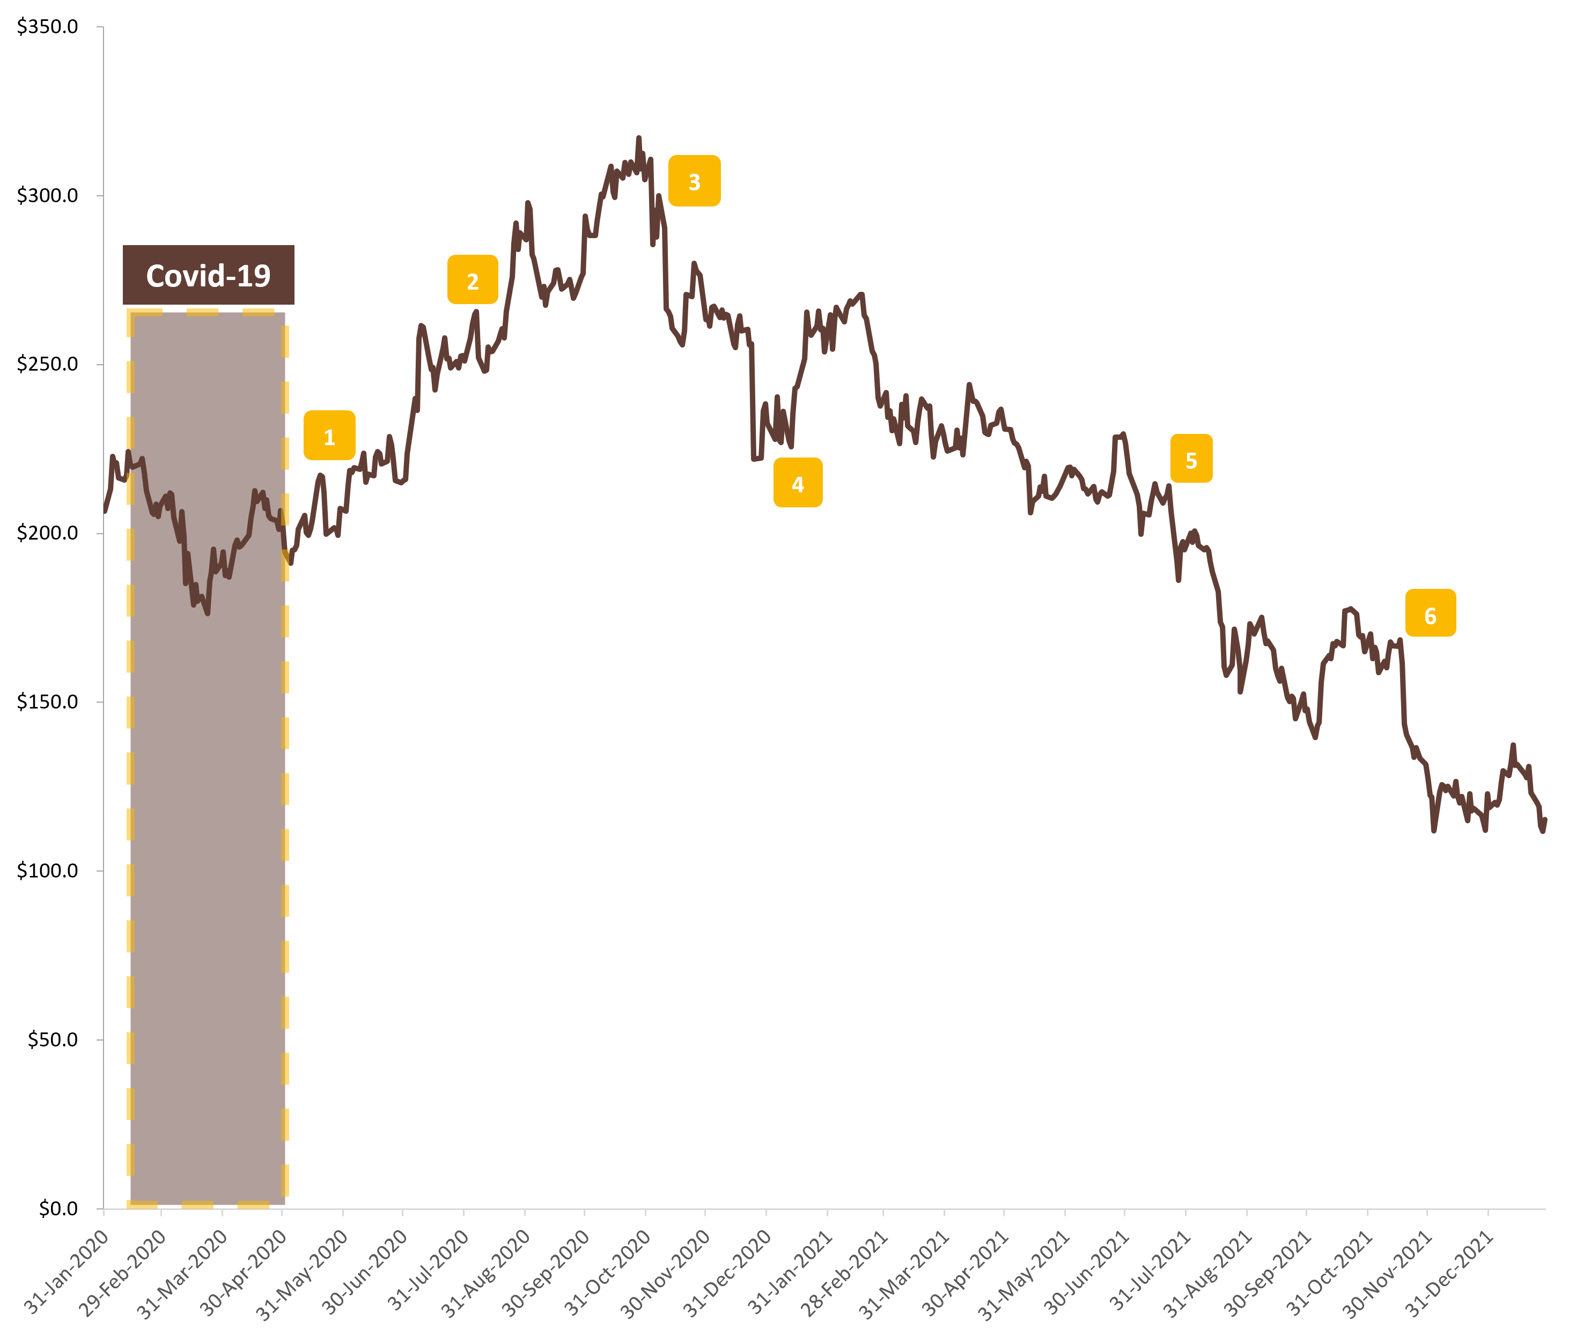
Annotated Price Chart
Stock Chart
Major Events
Announce that revenue growth is forecast to be slower reflecting the contraction within the Chinese economy
White house stepped up its confrontation with China by issuing a ban on TikTok and WeChat
Revenue grew at its slowest pace on record for a September quarter reflecting the plateau from the post-pandemic rebound
Jack Ma’s Ant Group planning to fold its financial operations into a holding company that could be regulated like a bank
Beijing clampdown on the private education industry
Alibaba slashed its outlook for 2022 revenue after intensifying competition and lower consumer spending
Sources: Company Website, Yahoo Finance

Slide 7
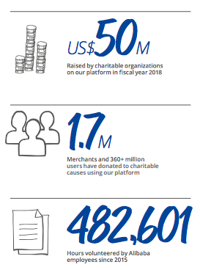
Alibaba & ESG
Initiatives:
- Plan to reach carbon neutrality by 2030, reduce its value chain’s carbon intensity by 50% by 2030
- Facilitate 1.5 gigaton decarbonization of its digital ecosystem by 2035
- 1/3 of management is female
- “Reunion” System for missing children 3,328 located since 2015, 97.6% success rate
- Helping people out of poverty with With Rural Taobao program: 30,000 villages now with service centers 730 countries to date helped
Notes:
7 issues Alibaba considers most critical to the sustainability of their business:
-Corporate governance, intellectual property rights protection, cybersecurity, data protection, human capital, social impact, environmental impact

Slide 8
Section II. Industry Overview
Analyst(s): Elias Kott and Patrick Seeley

Slide 9
E-Commerce Industry Overview
The E-Commerce industry generated roughly $880B in 2021, with >50% coming from Asia alone. Alibaba overwhelmingly controls most of the Asian market share.
Asia (Developed) Market Share - % of Rev.
Global Market Share - % of Rev.
Asia (Developed) Market Share - % Mkt. cap
Global Market Share - % Mkt. cap
Sources: Bloomberg CCB Function

Slide 10
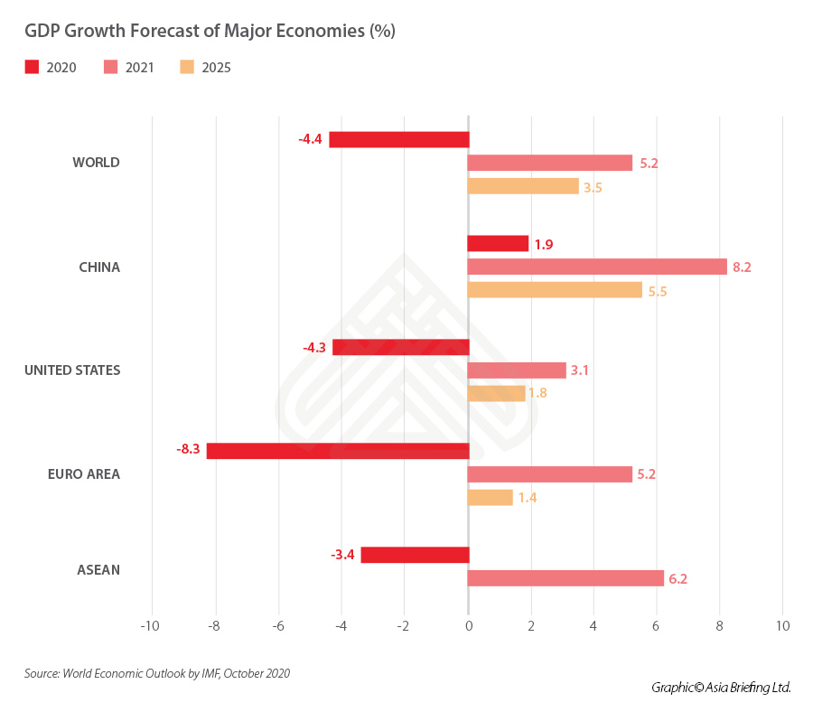
Macro Overview
China has the most online buyers and sellers aided by being the world’s most populous nation. At the end of 2020, it had 782 million online consumers, more than twice the US population, the next largest market. Its largest e-commerce platform, Alibaba’s Taobao, has 4.5 million active sellers in the country. In contrast, US e-commerce giant Amazon has 1.5 million active sellers worldwide.
Sources: China Briefing, Yahoo Finance

Slide 11
Section IV. Risks & Catalysts
Analyst(s): Patrick Seeley and Elias Kott

Slide 12
Risks and Catalysts
Risks
Catalysts
COVID-19 supply chain disruptions
Political instability and legal sanctions from China
Economic downturns could impact discretionary spending
Expansion of other e-commerce competitors
Economic recovery could increase discretionary spending
The largest e-commerce company is also in the largest market in the world
CAGR is 13%, strong for an already established company
Increases in daily ordering, such as the recent increase of 400% Y/Y
Although Alibaba faces the risks of supply chain problems and government regulations, as well as the rise of other competitors, they are firmly the top e-commerce company in China and should continue to see growth.
Alibaba’s position as the strongest force in e-commerce in the most populous country in the world allows the company to see rapid growth as China continues to develop. This growth should continue into the foreseeable future.
Sources: Company Website, SEC 10Ks 10Qs, Yahoo Finance

Slide 13
Section V. Valuation
Analyst(s): Colin Fragale

Slide 14
Comparable Company Analysis – Base Case

Slide 15
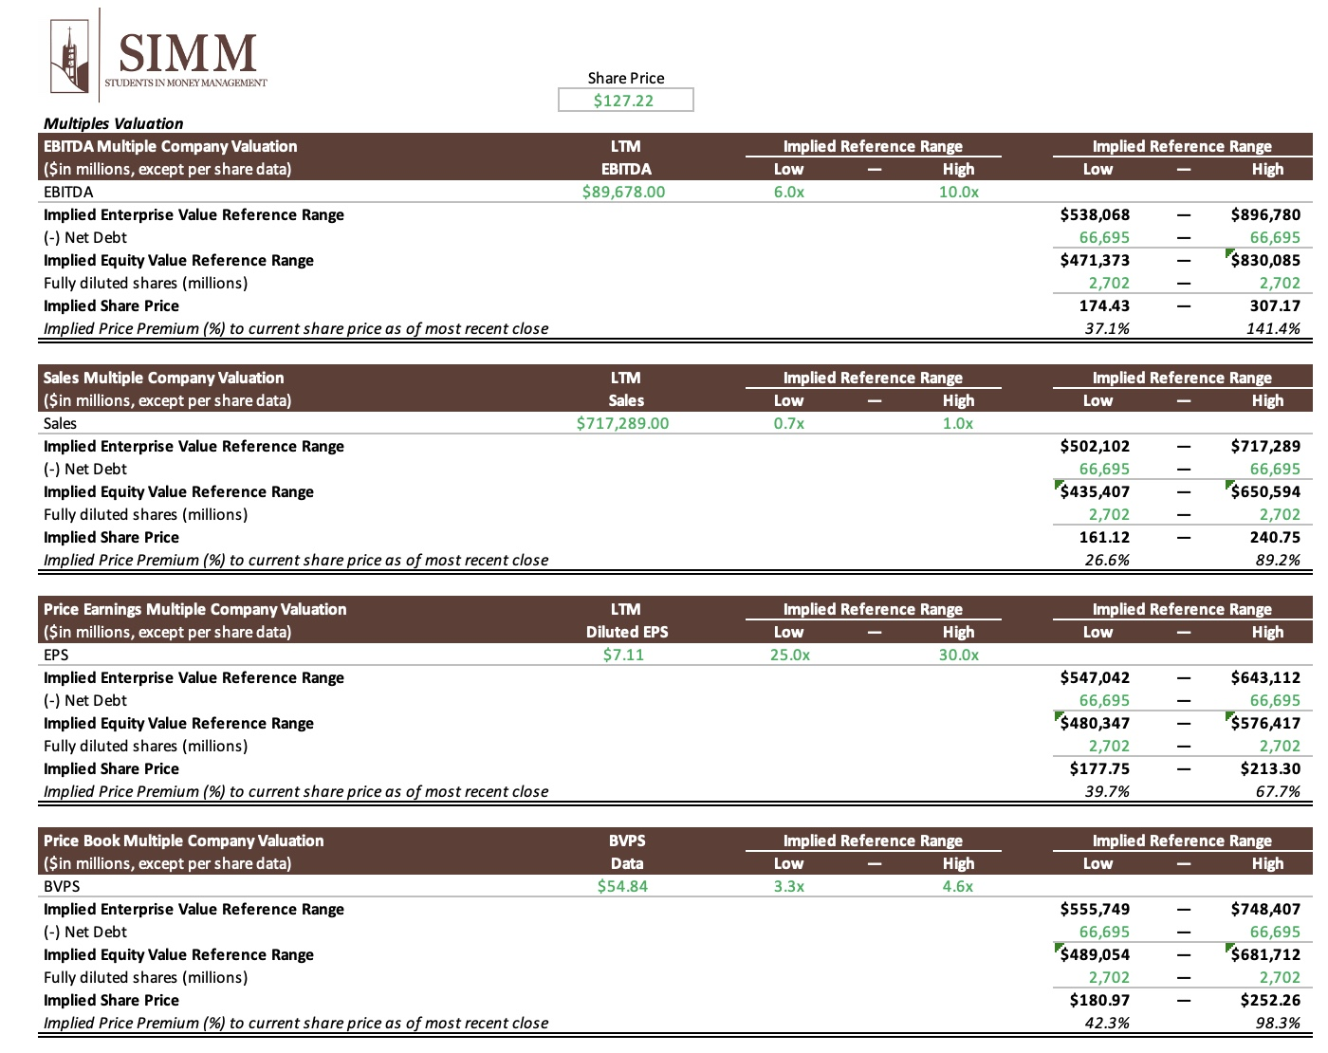
Multiples Analysis – Base Case

Slide 16
Section VI. Investment Thesis
Analyst(s): Colin Fragale & Pat Mann

Slide 17
BABA Investment Thesis
Company Overview / Story - Mature
Business Model / Growth Strategy
The worlds biggest online commerce company founded in 1999 lead by Jack Ma
Three main sites; Taobao, Tmall, and Alibaba.com with transactions totaling $248 Billion last year – More than Ebay and Amazon combined
There are nearly a billion users and hosts millions of merchants and business
Alibaba’s business is selling goods online, much like Amazon.
Their target market is the entirety of China
The company’s growth strategy is to increase their consumer base by providing the best goods conveniently
Risks & Catalysts
Valuation
Two Risks are:
COVID-19 supply chain disruptions
Political instability and legal sanctions from China
Two Catalysts are:
The largest e-commerce company is also in the largest market in the world
CAGR is 13%, strong for an already established company
We performed a comparable analysis followed by a multiples analysis
They suggested that Alibaba is currently undervalued.
We weighted our DCF to Perpetuity and our Price to Book valuations the highest as they seemed most applicable to Reliance and their industry
Investment Thesis - Buy
Alibaba’s position as the top e-commerce business in China allows them to undergo much growth
We are suggesting a market order with a price target of $180. We expect an investment horizon of approximately 10-12 months, but will reevaluate the position consistently
We want a trailing stop loss of 12% put into place after the trade is executed to ensure security in case of any adverse market reactions

Slide 18
Recommendation
Buy Recommendation
Change in Consumer Discretionary
“We want to initiate a 3.0% position in Alibaba at a price target of $180.00, representing a 41.5% potential upside from the current market price.”
Sources: Yahoo finance, SIMM Google Sheet

